Slide 1
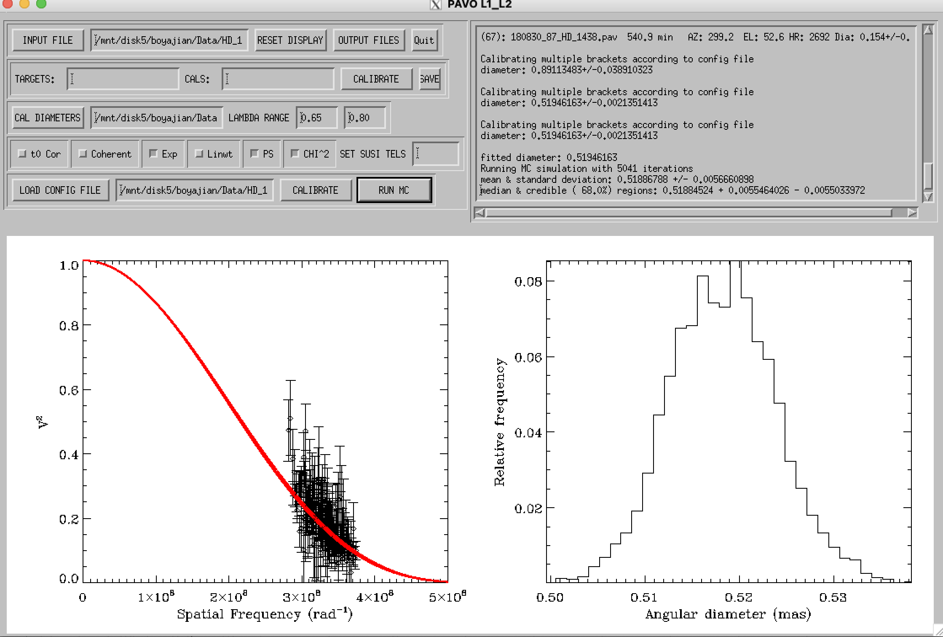
Hd 10697

Slide 2
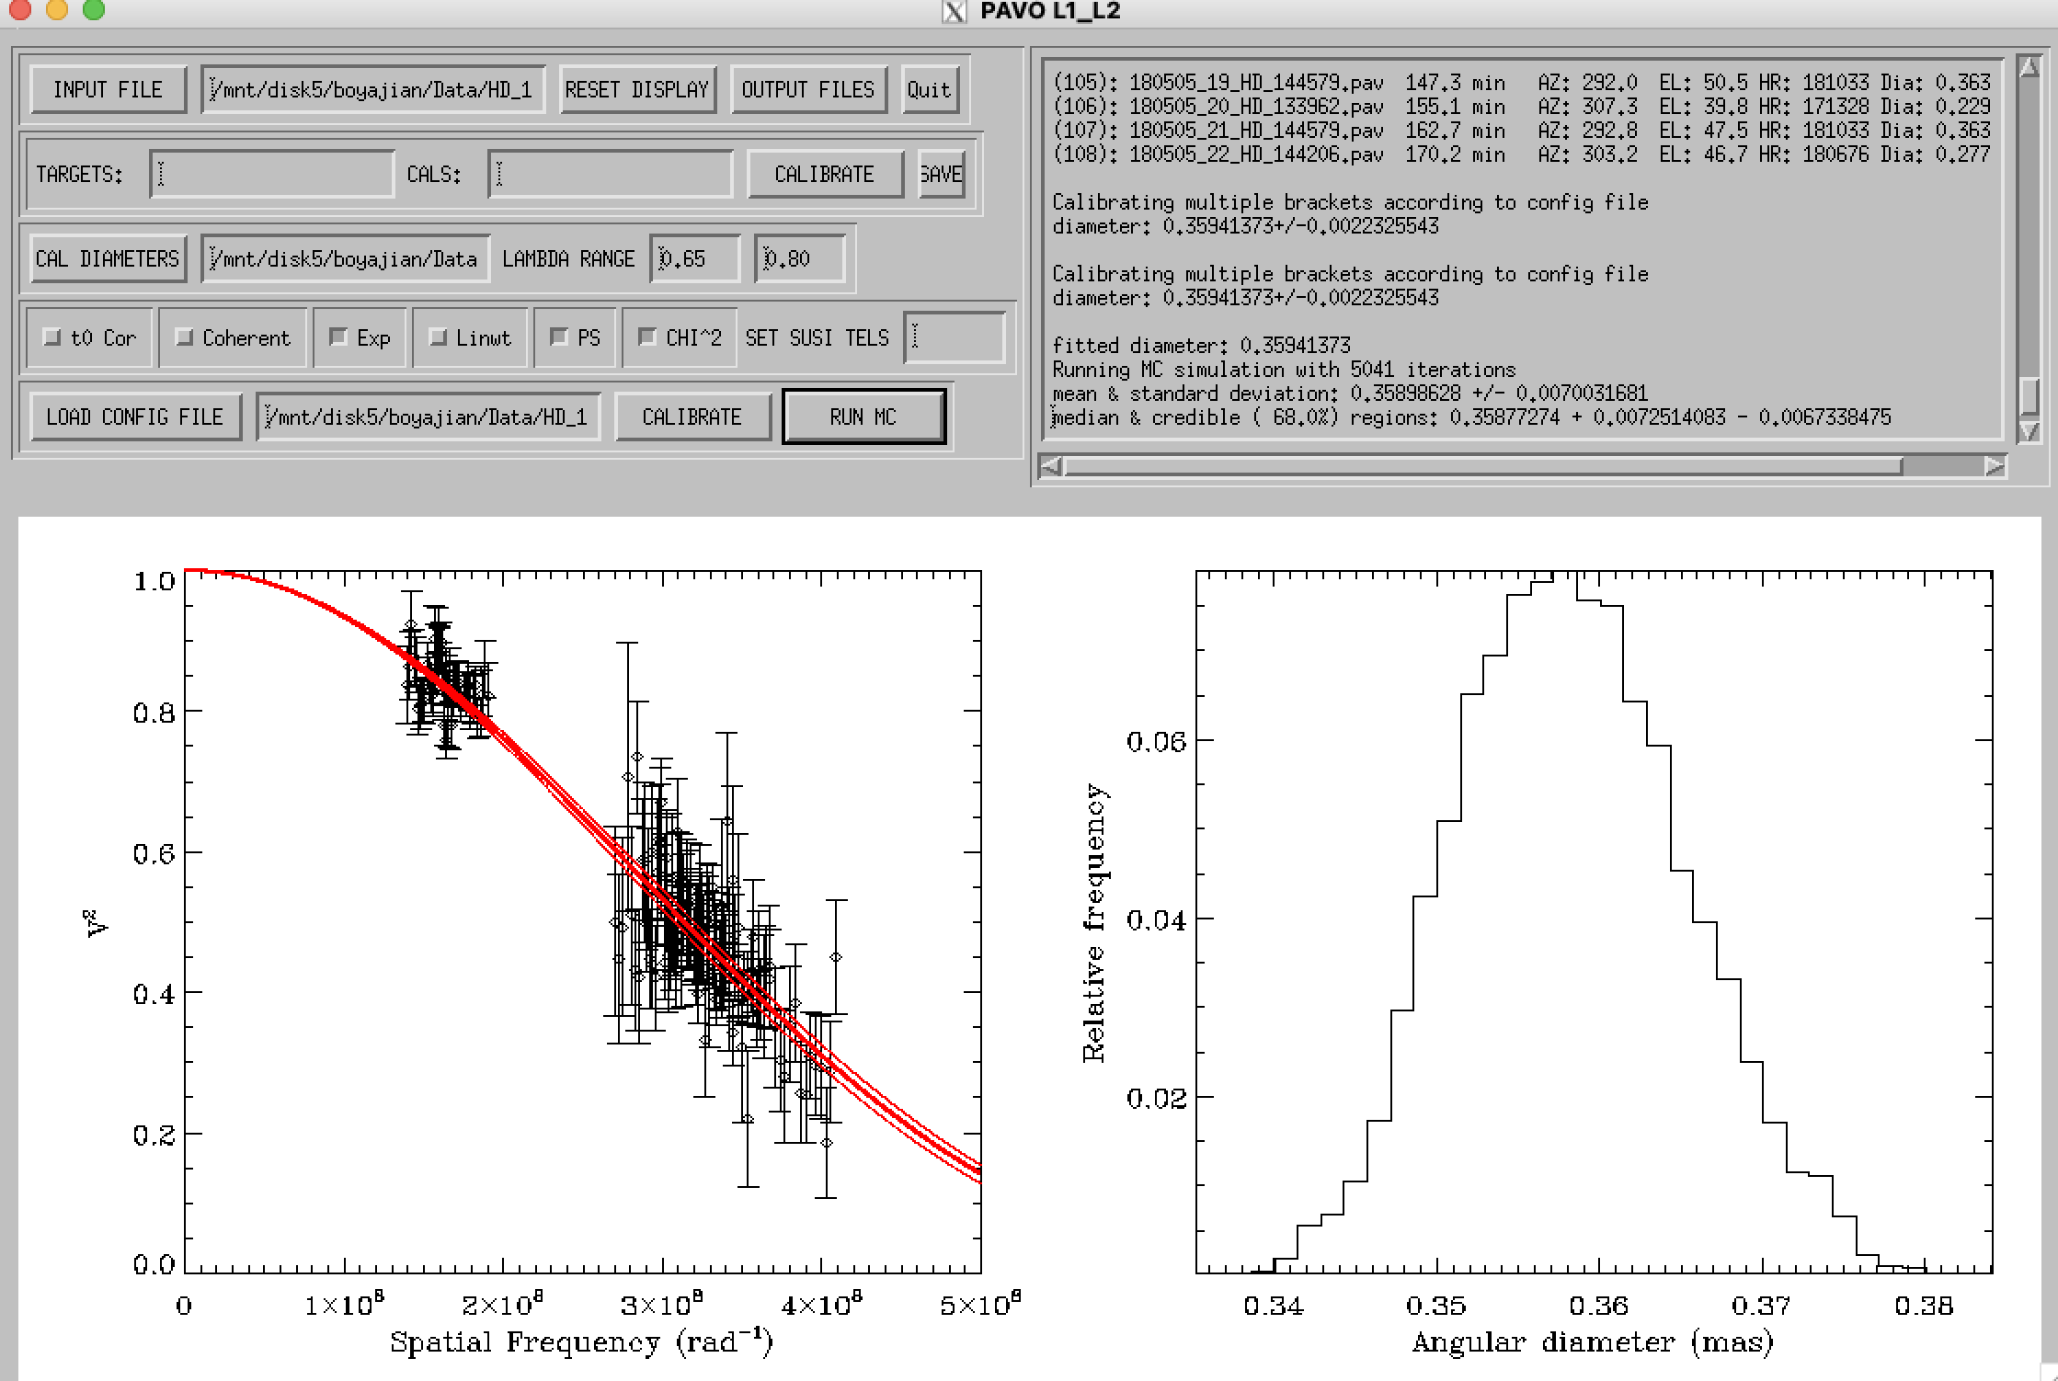
Hd 108510

Slide 3
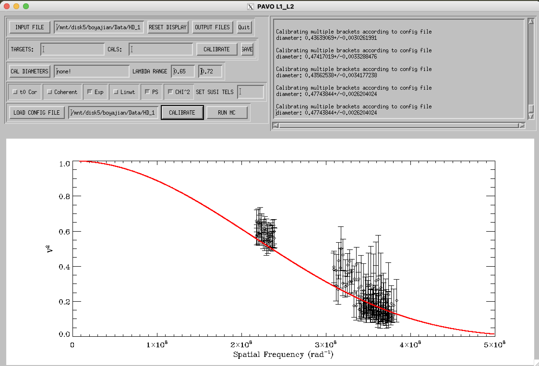
Hd 113337
With 170602

Slide 4
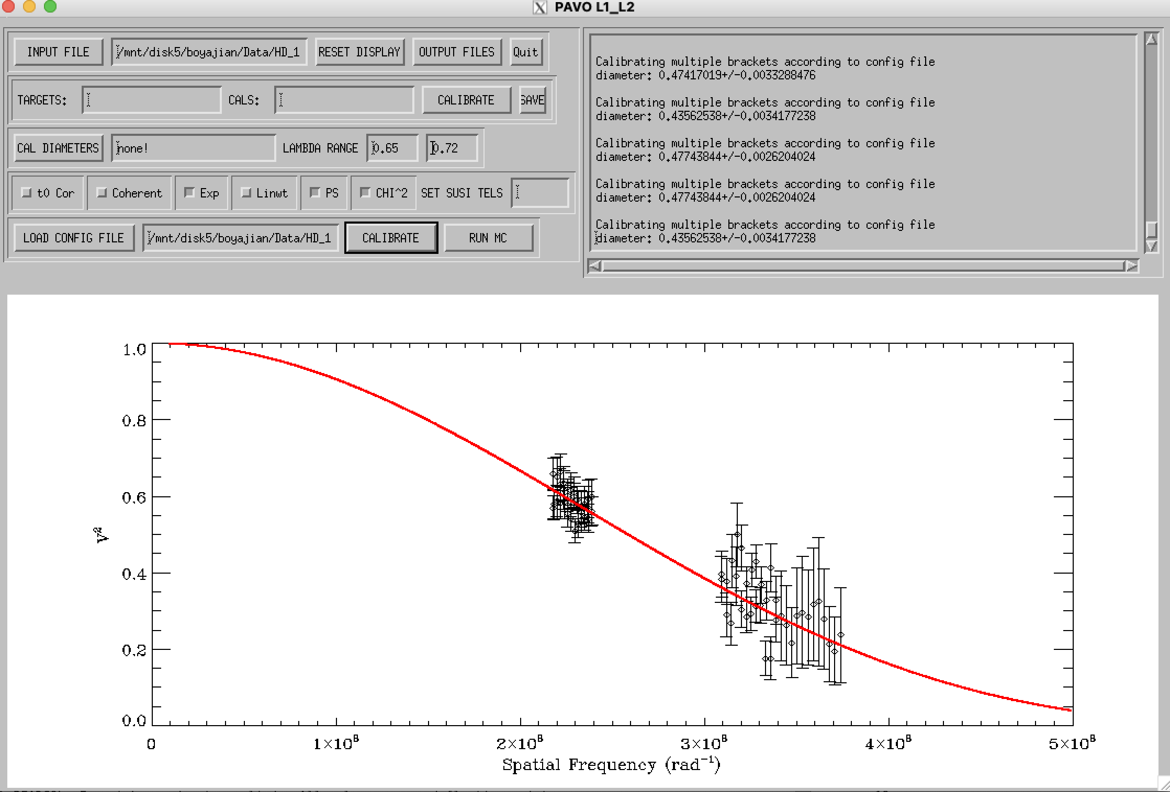
Hd 113337
Without data from 170602

Slide 5
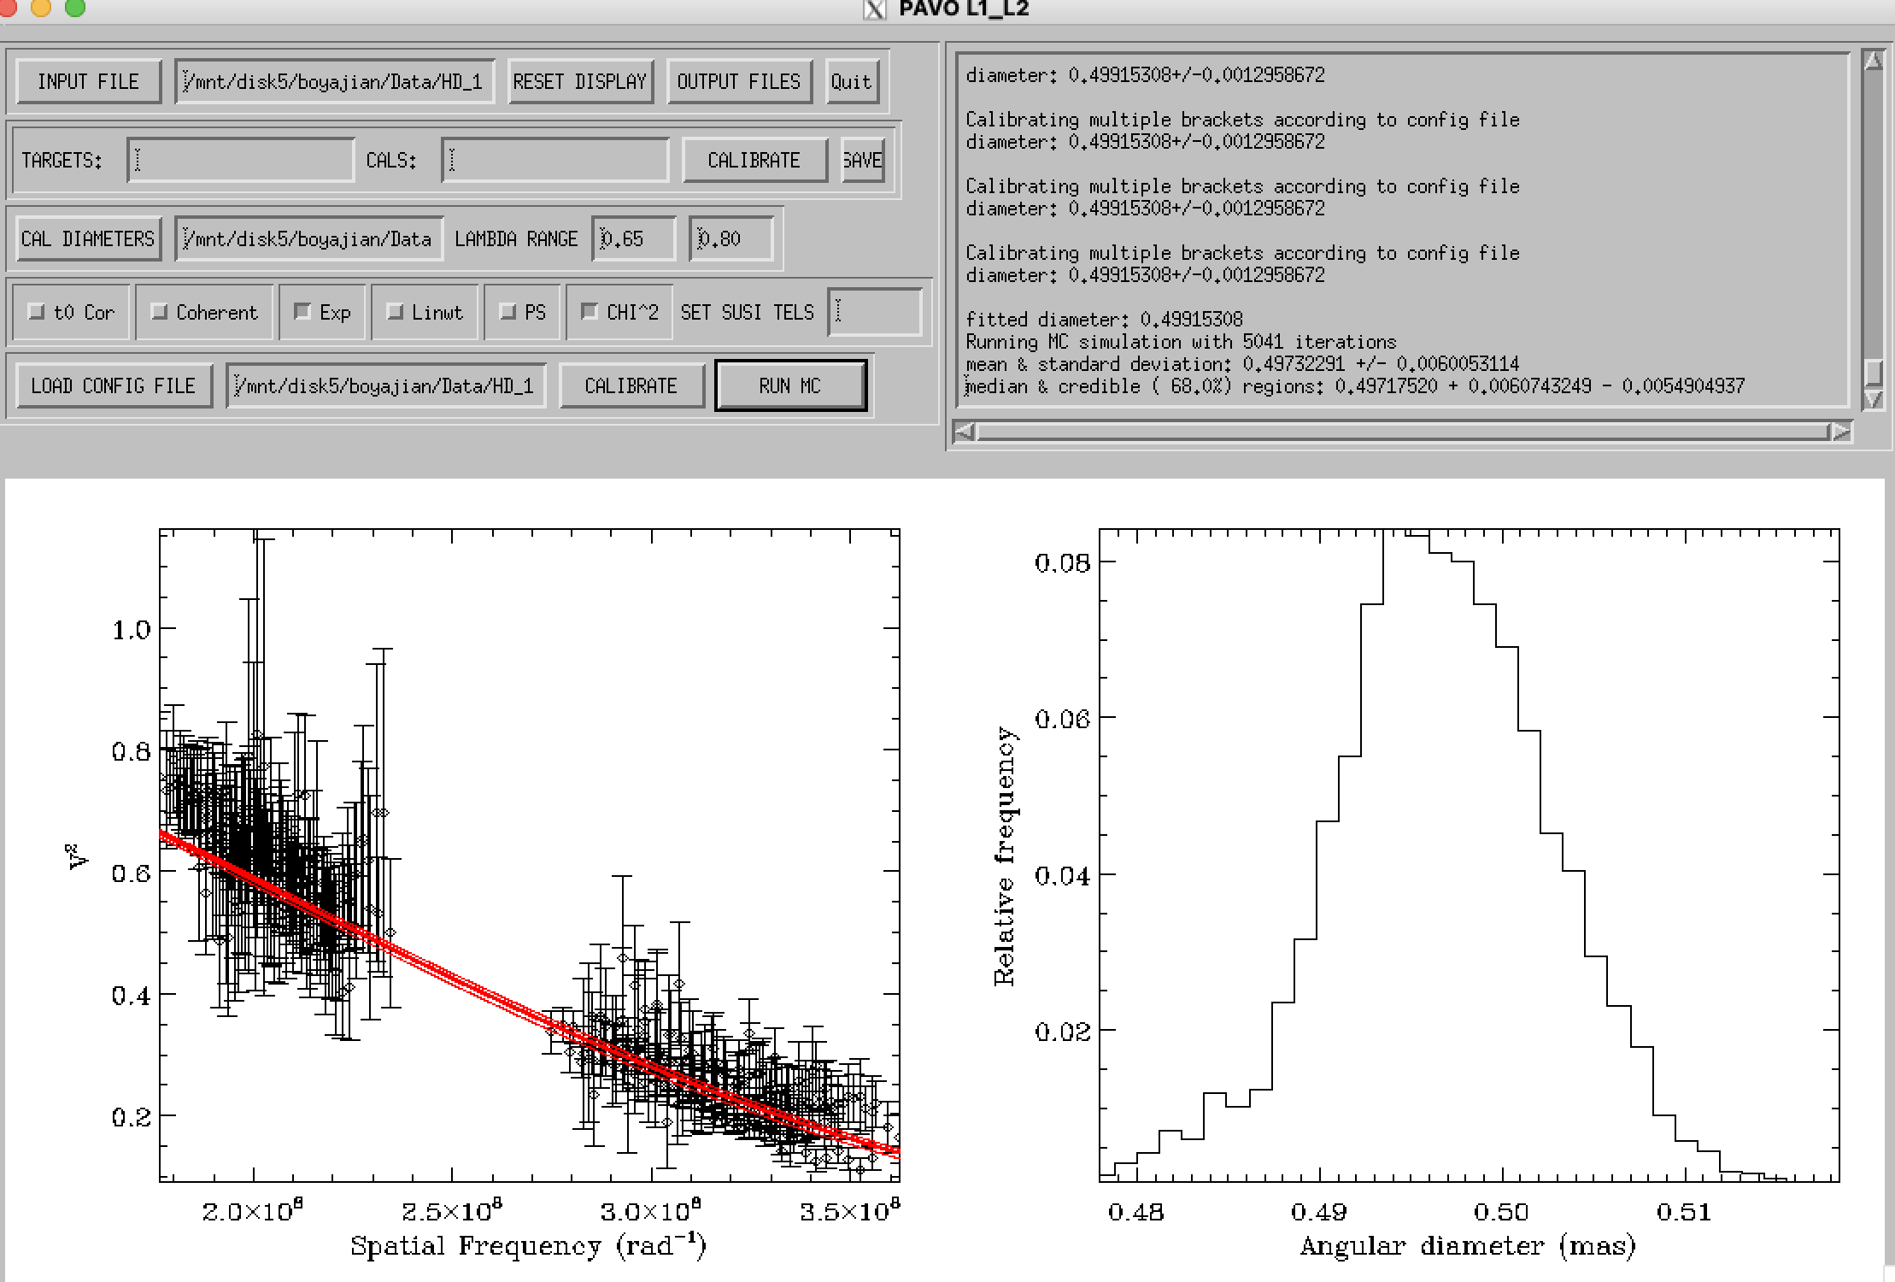
Hd 127334

Slide 6
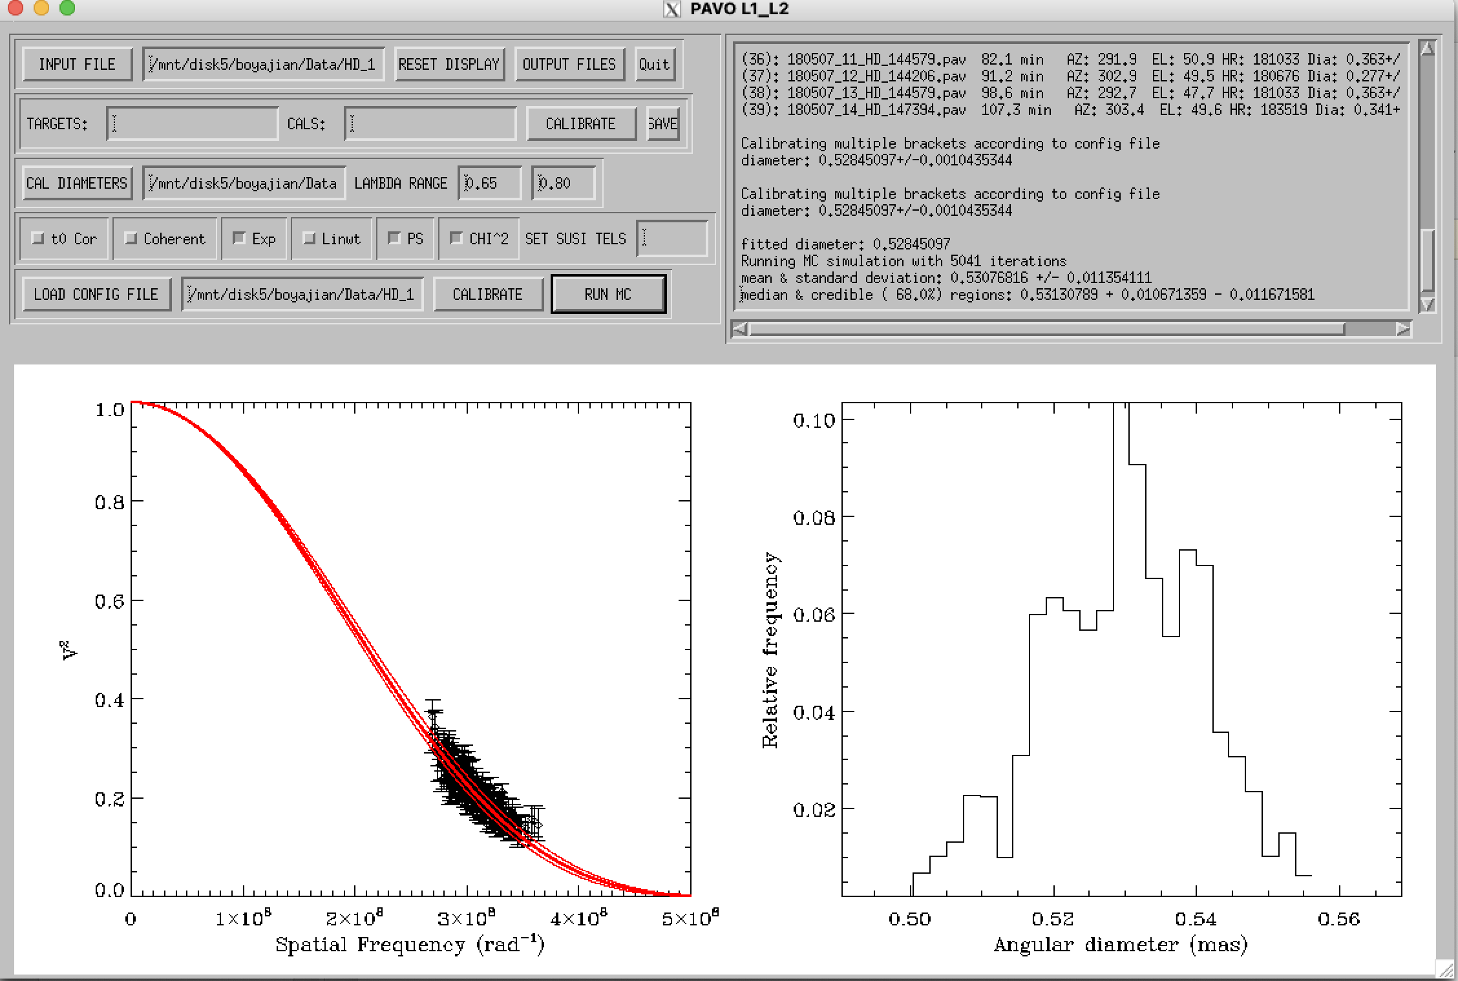
Hd 144579

Slide 7
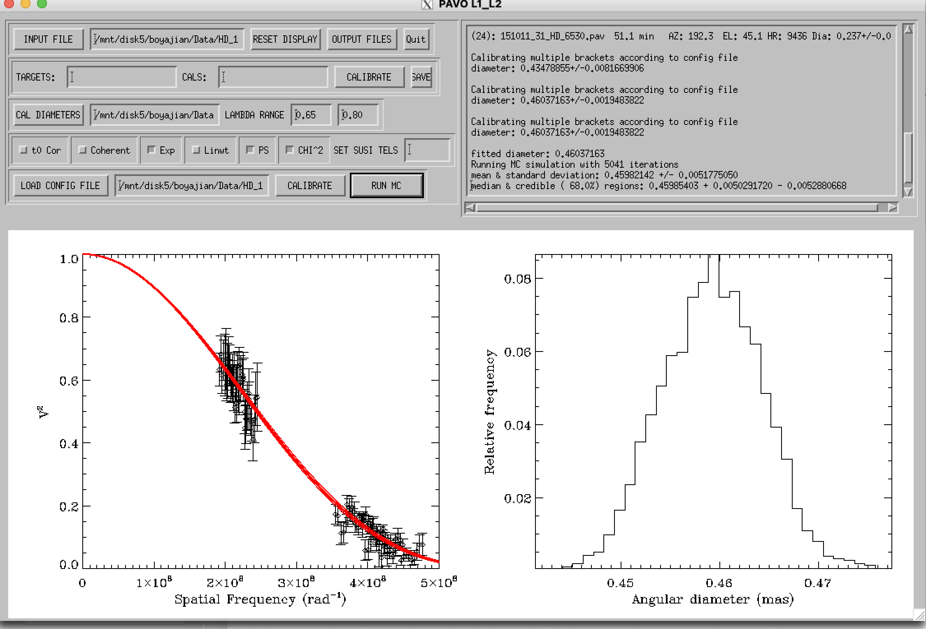
Hd 1461

Slide 8
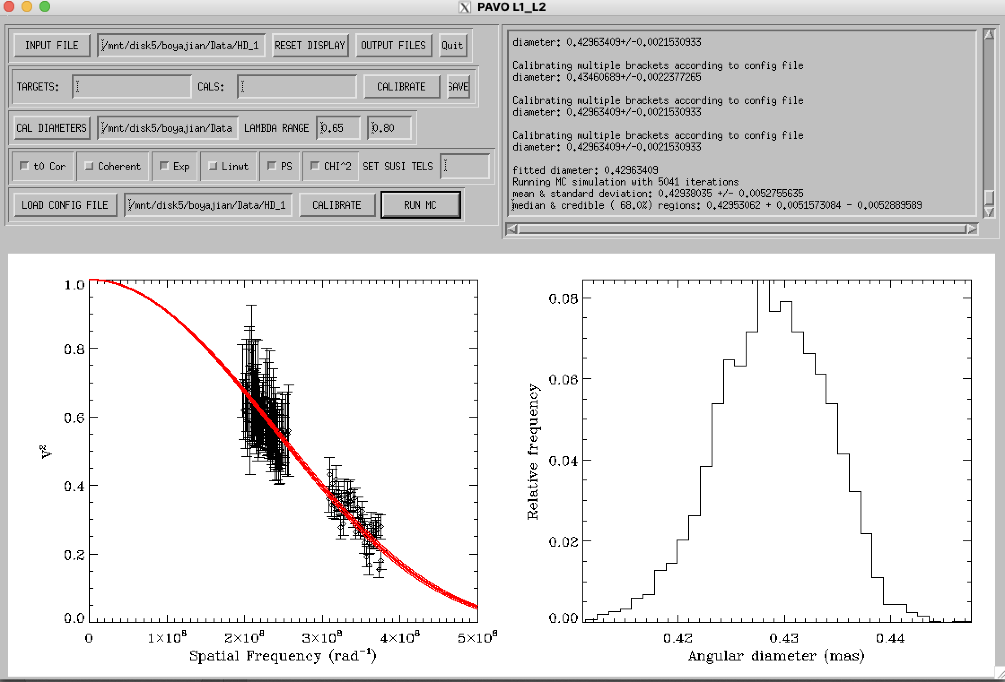
Hd 154345

Slide 9
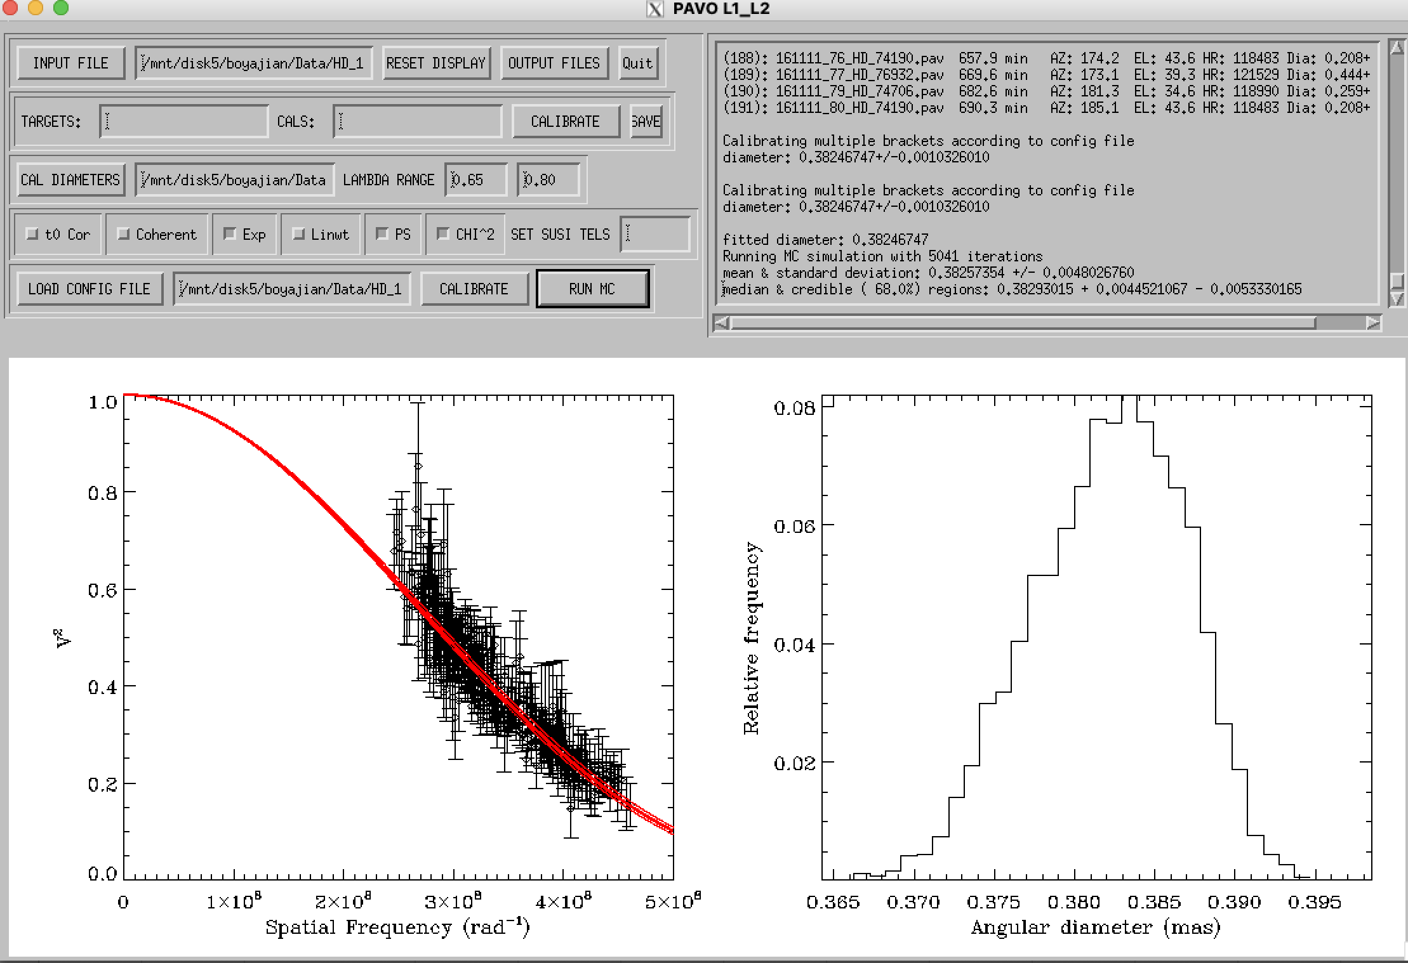
Hd 16141

Slide 10
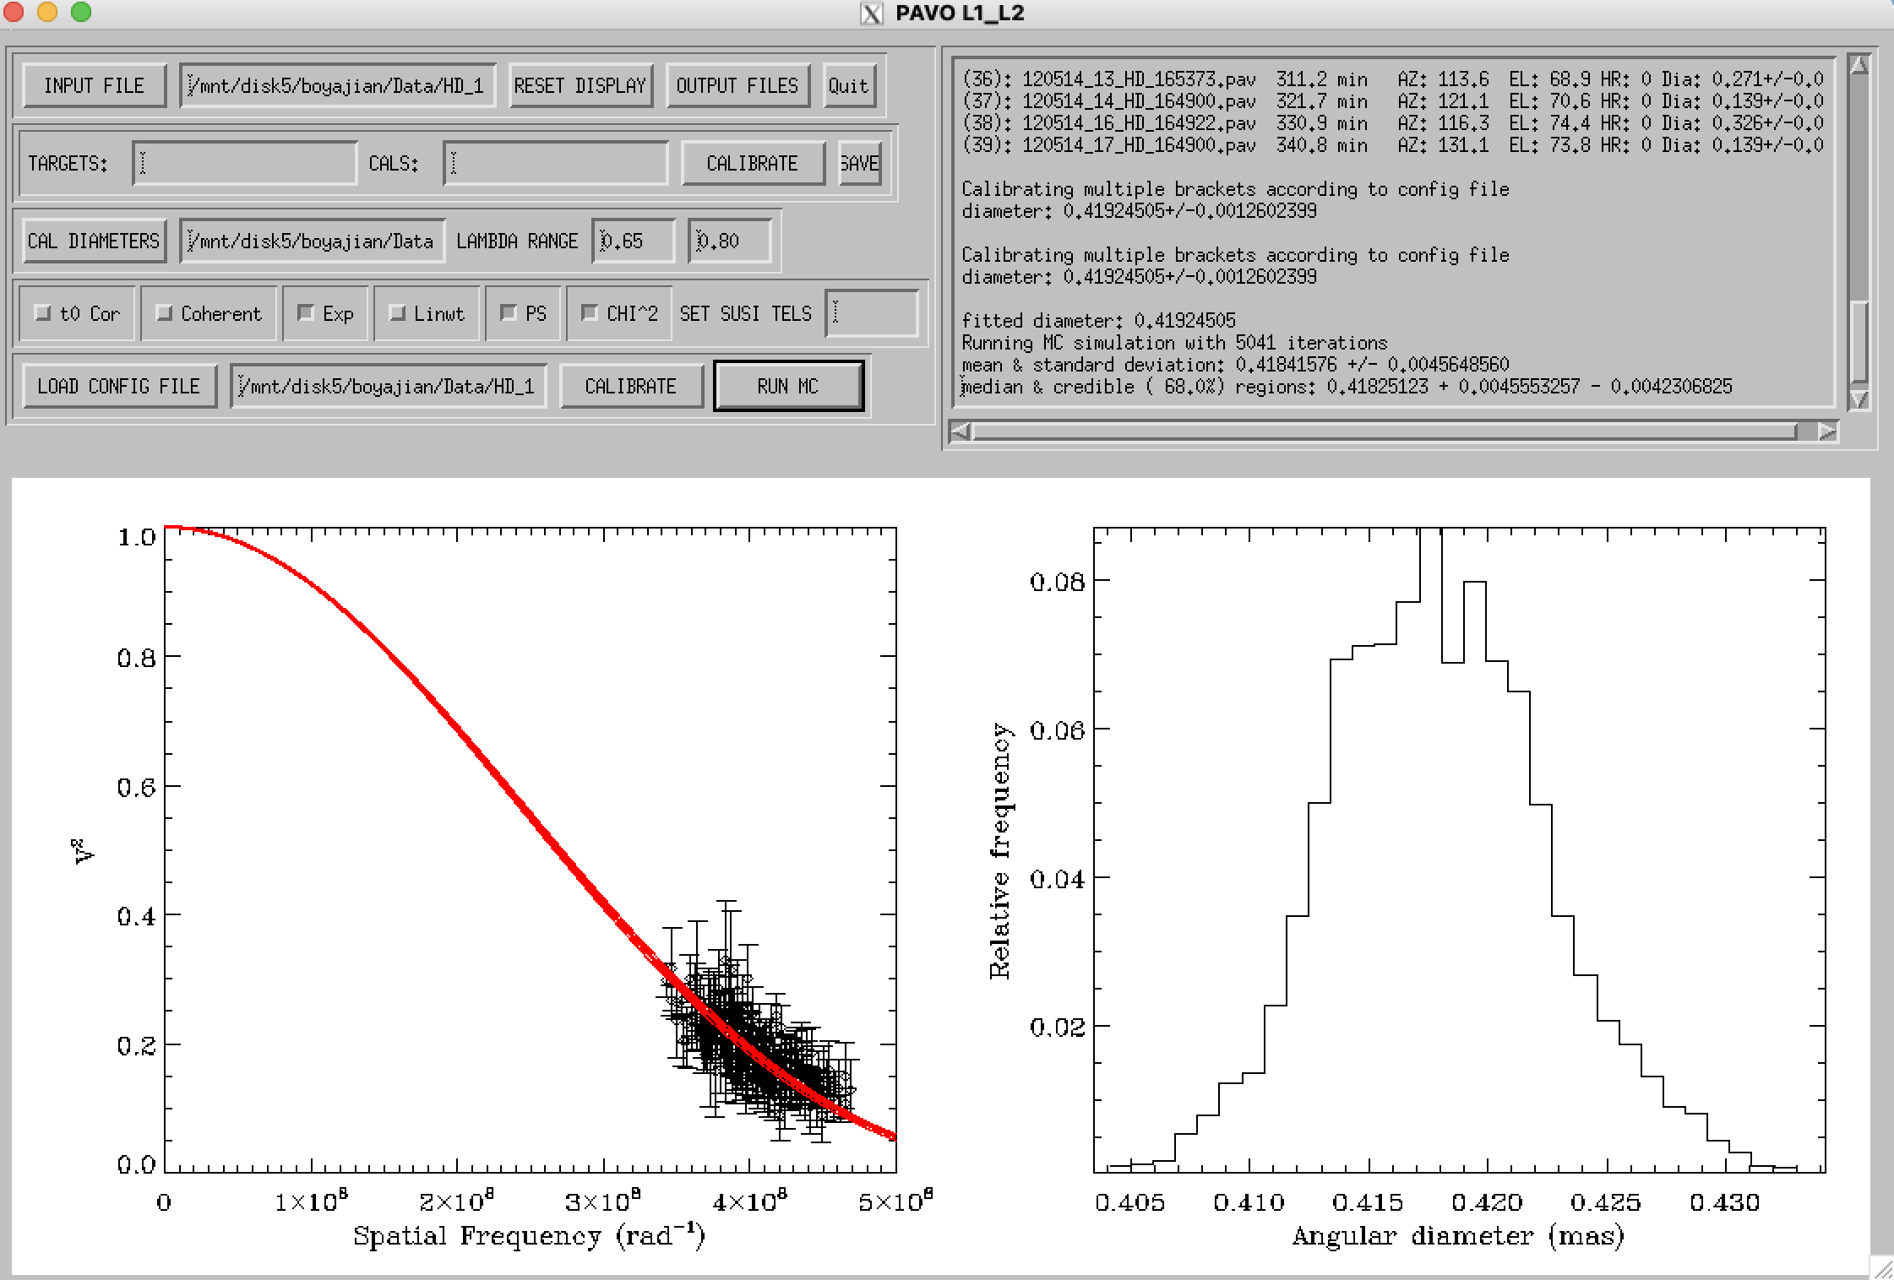
Hd 164922

Slide 11
Hd 168443
Not enough data

Slide 12
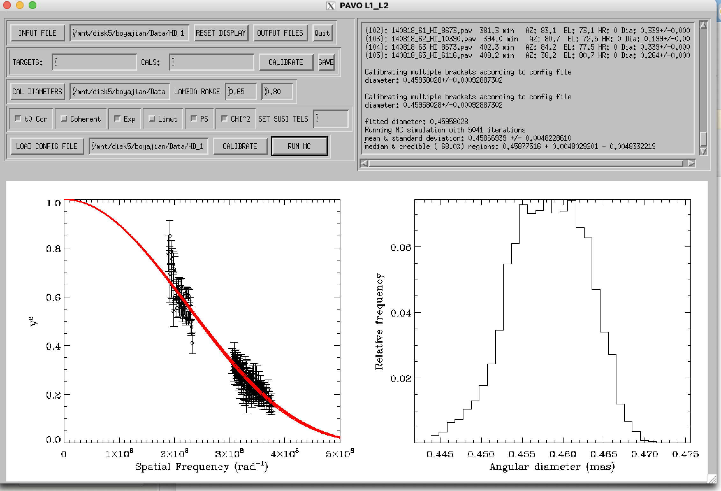
Hd 181096

Slide 13
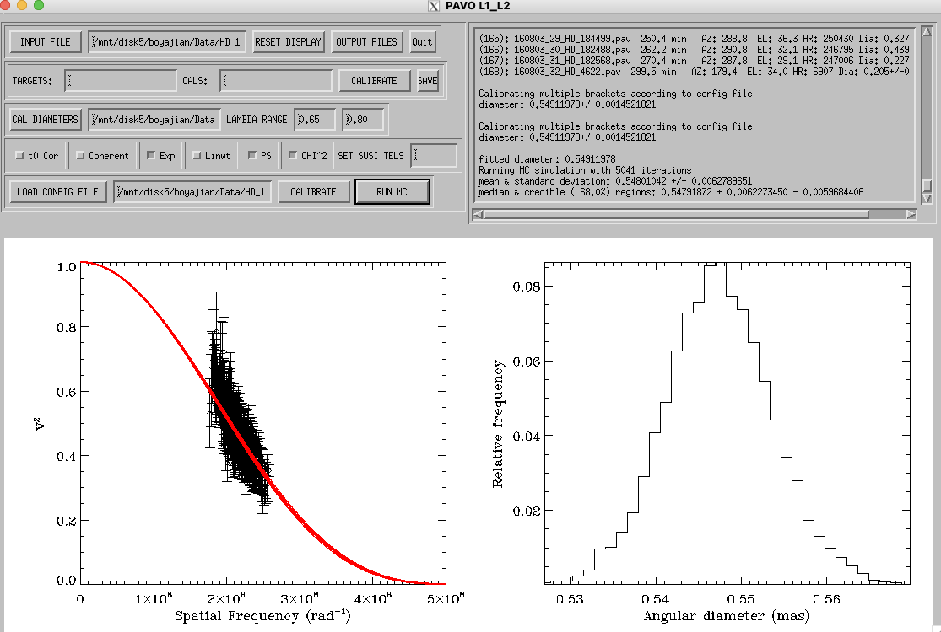
Hd 182488

Slide 14
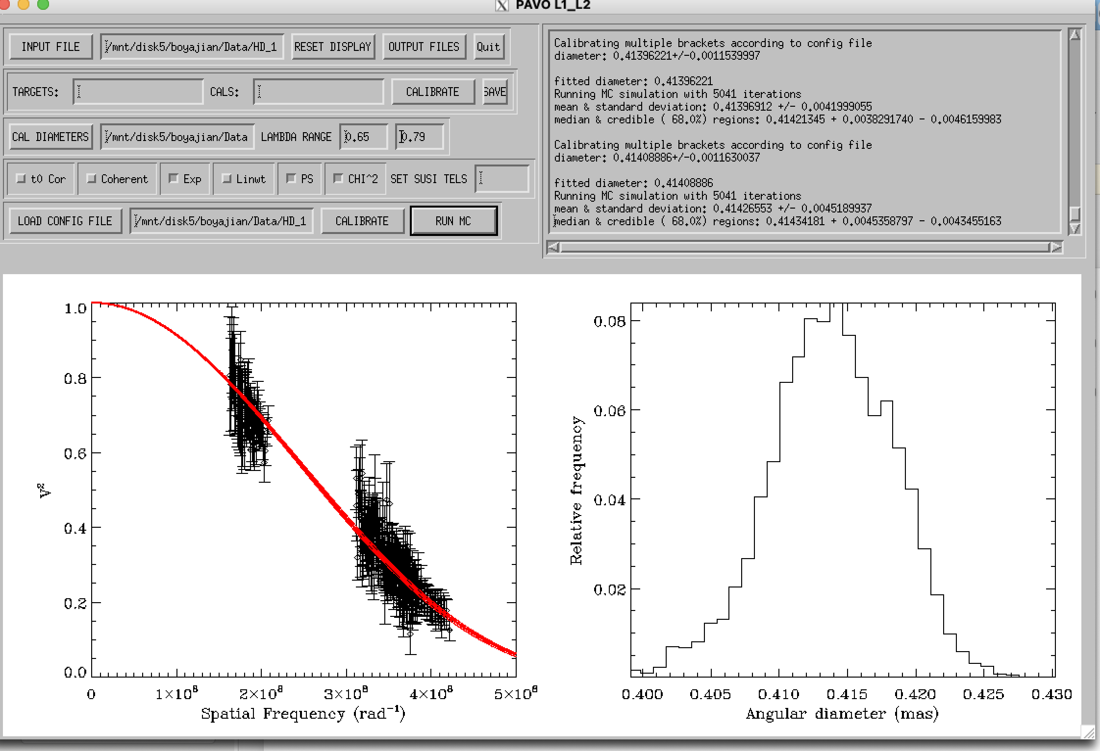
Hd 184499 wave<0.79

Slide 15
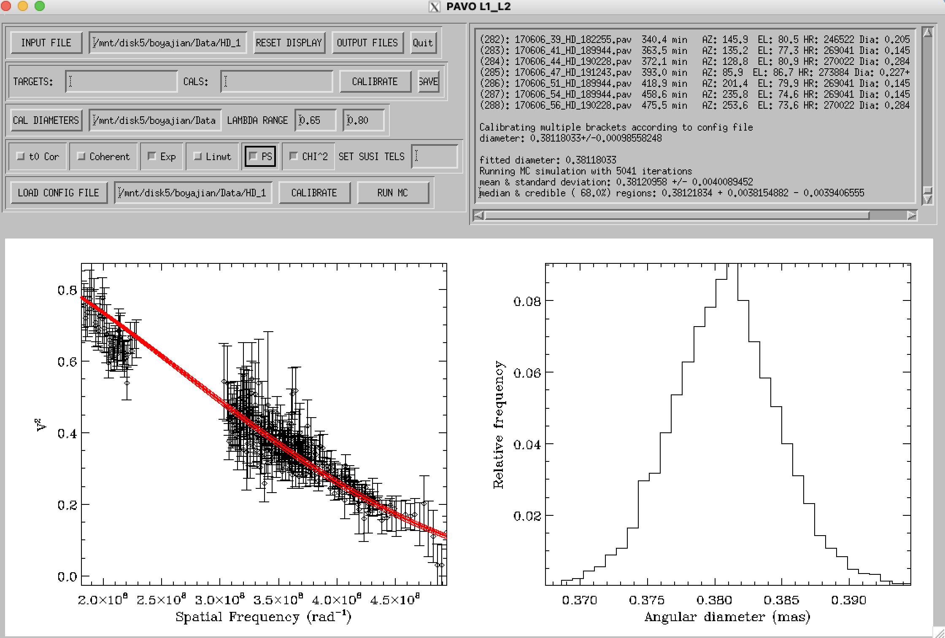
Hd 185269

Slide 16
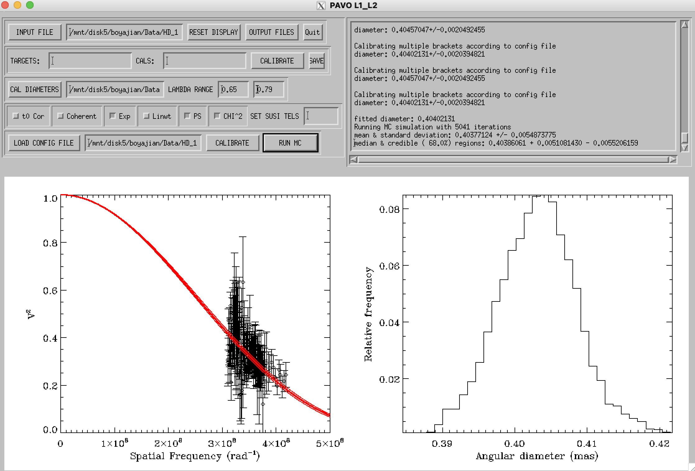
Hd 190228 wave<0.79

Slide 17
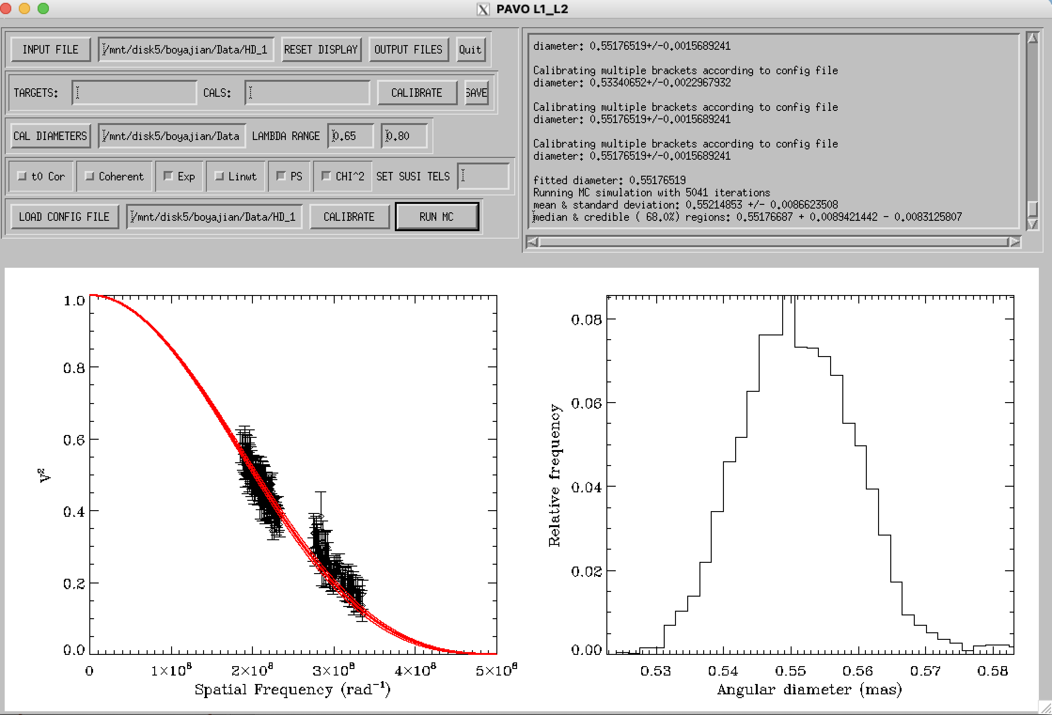
Hd 193664

Slide 18
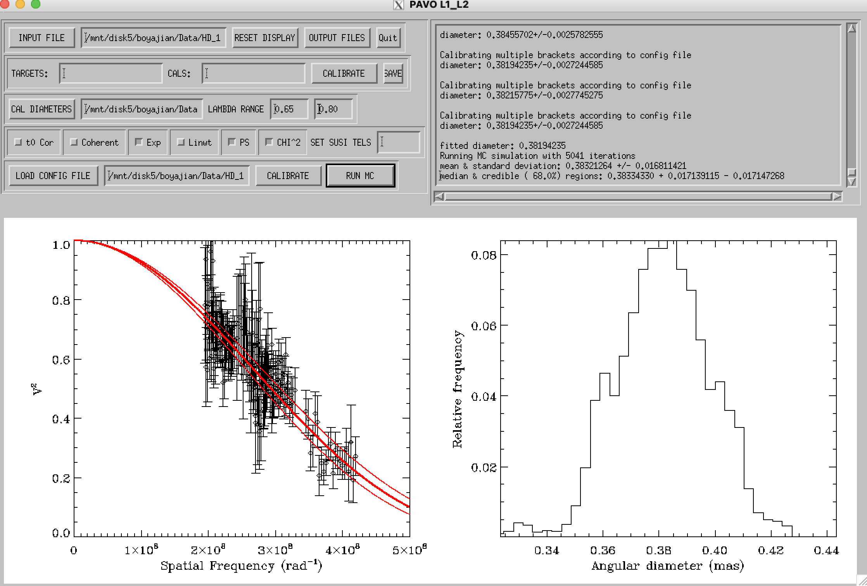
Hd 195019

Slide 19
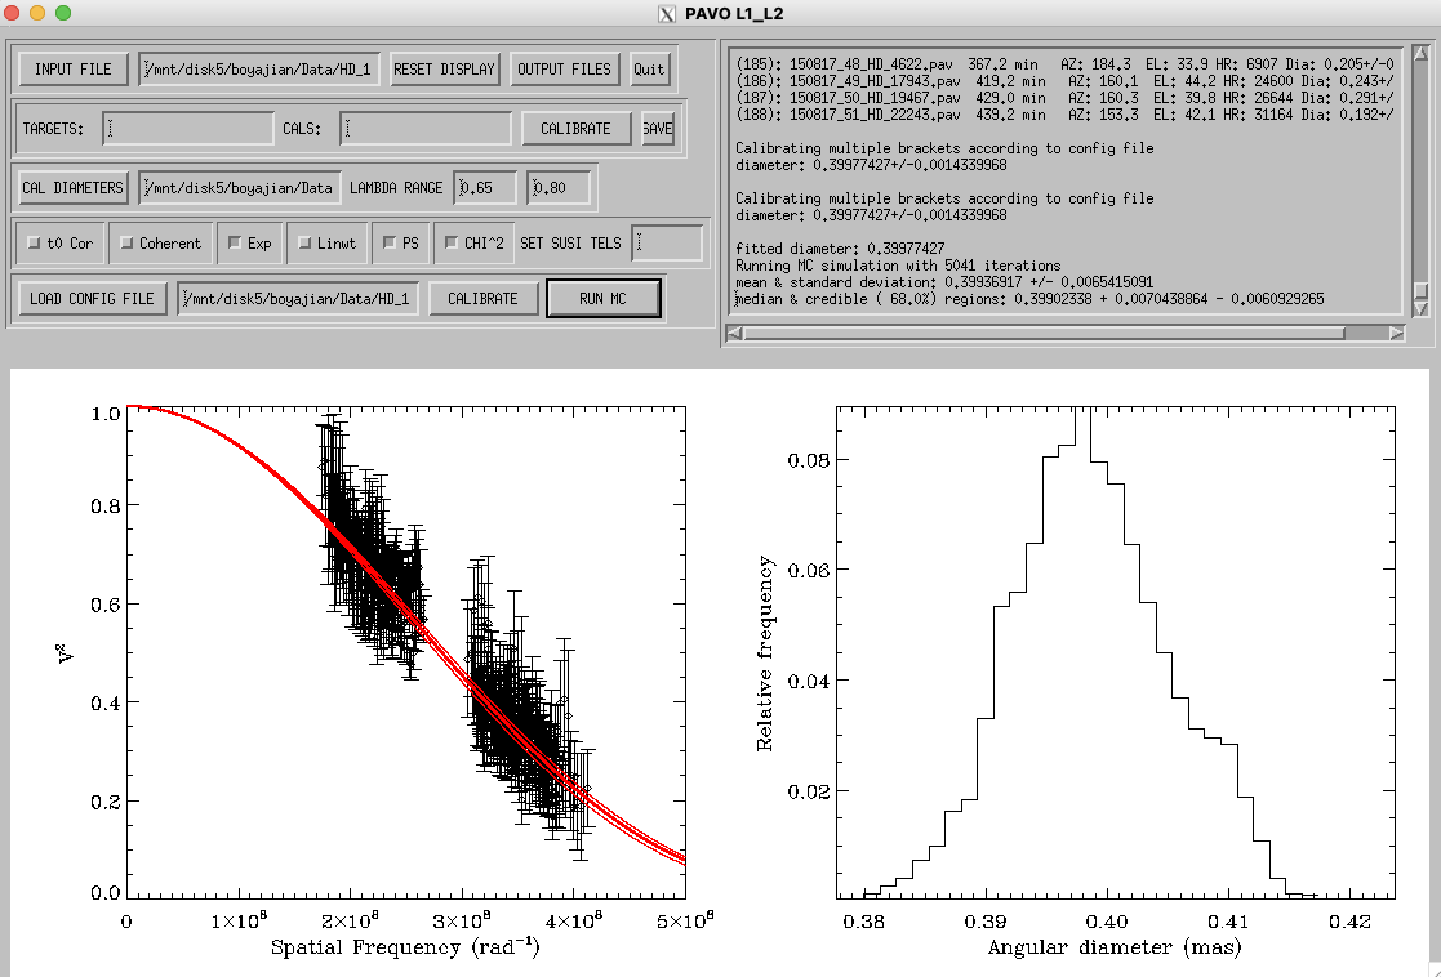
Hd 196885

Slide 20
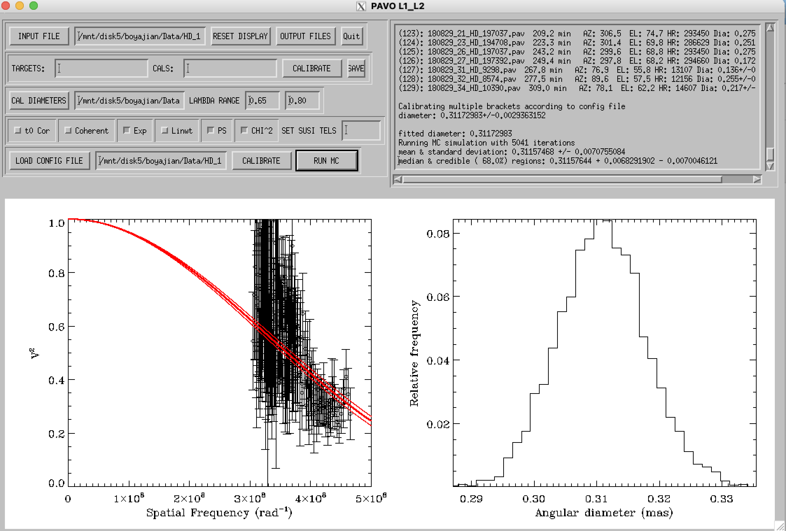
Hd 197037 questionable!

Slide 21
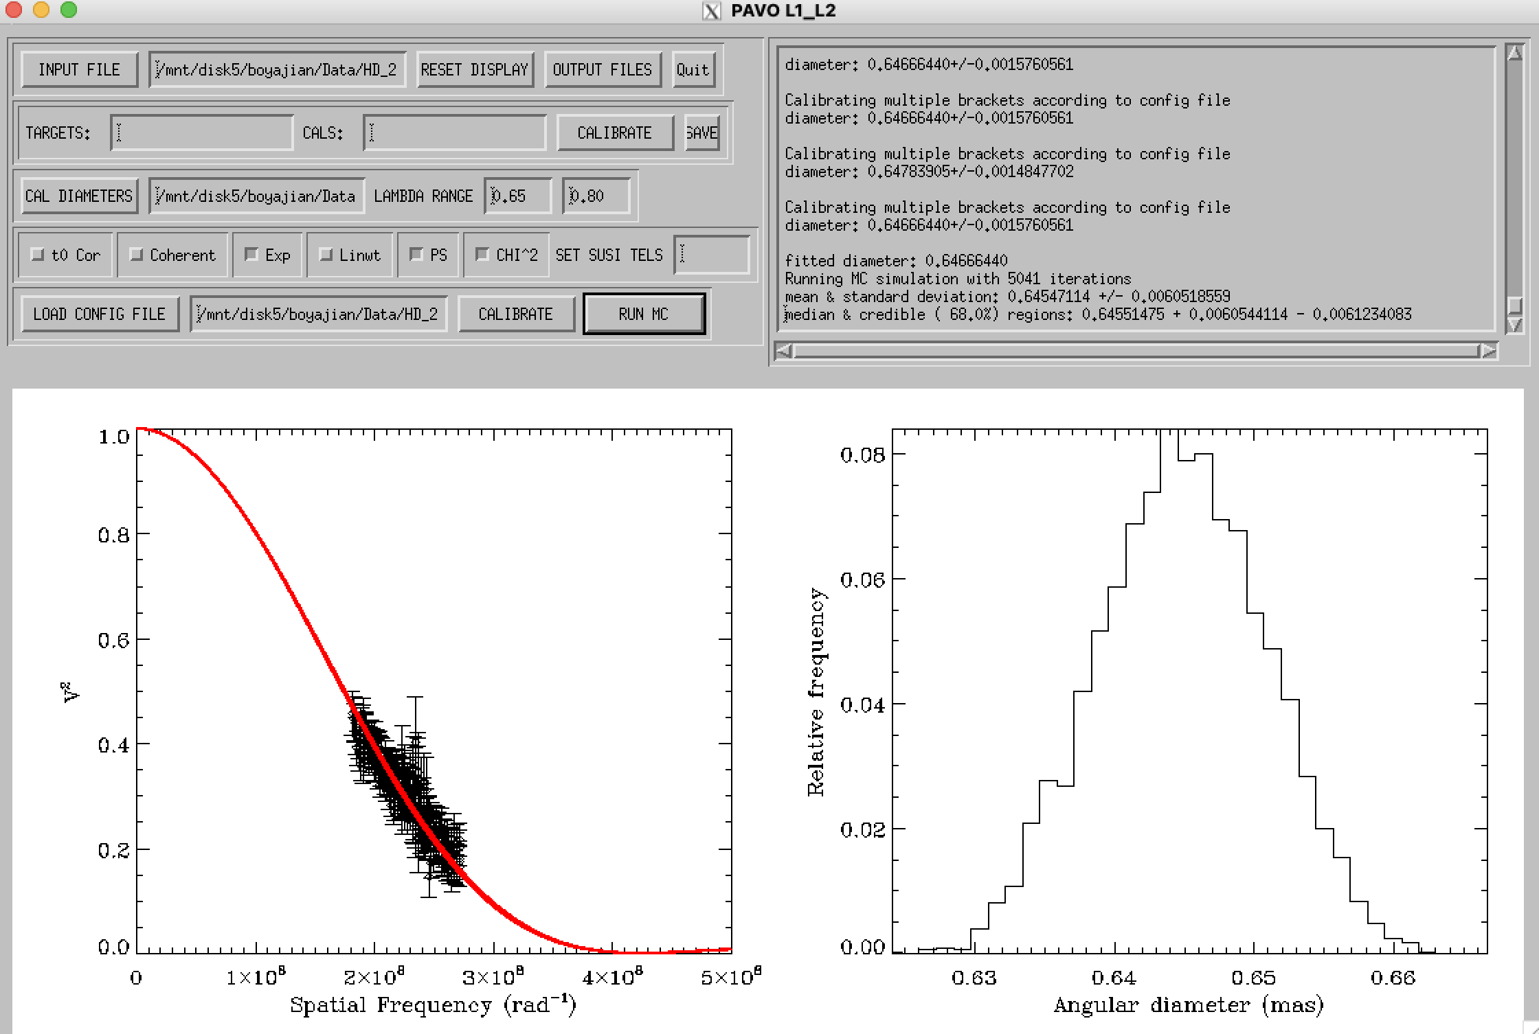
Hd 202568 only one cal…

Slide 22
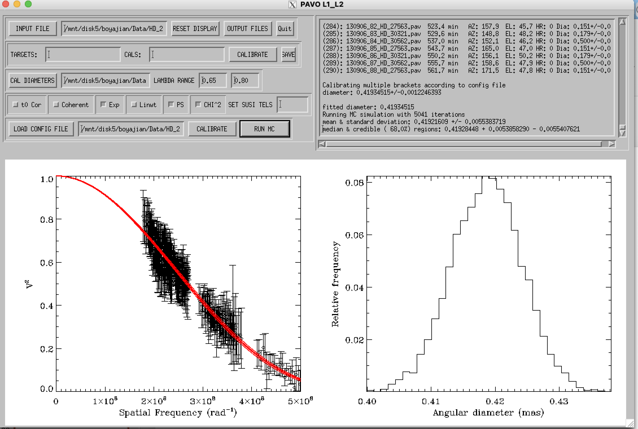
Hd 20367

Slide 23
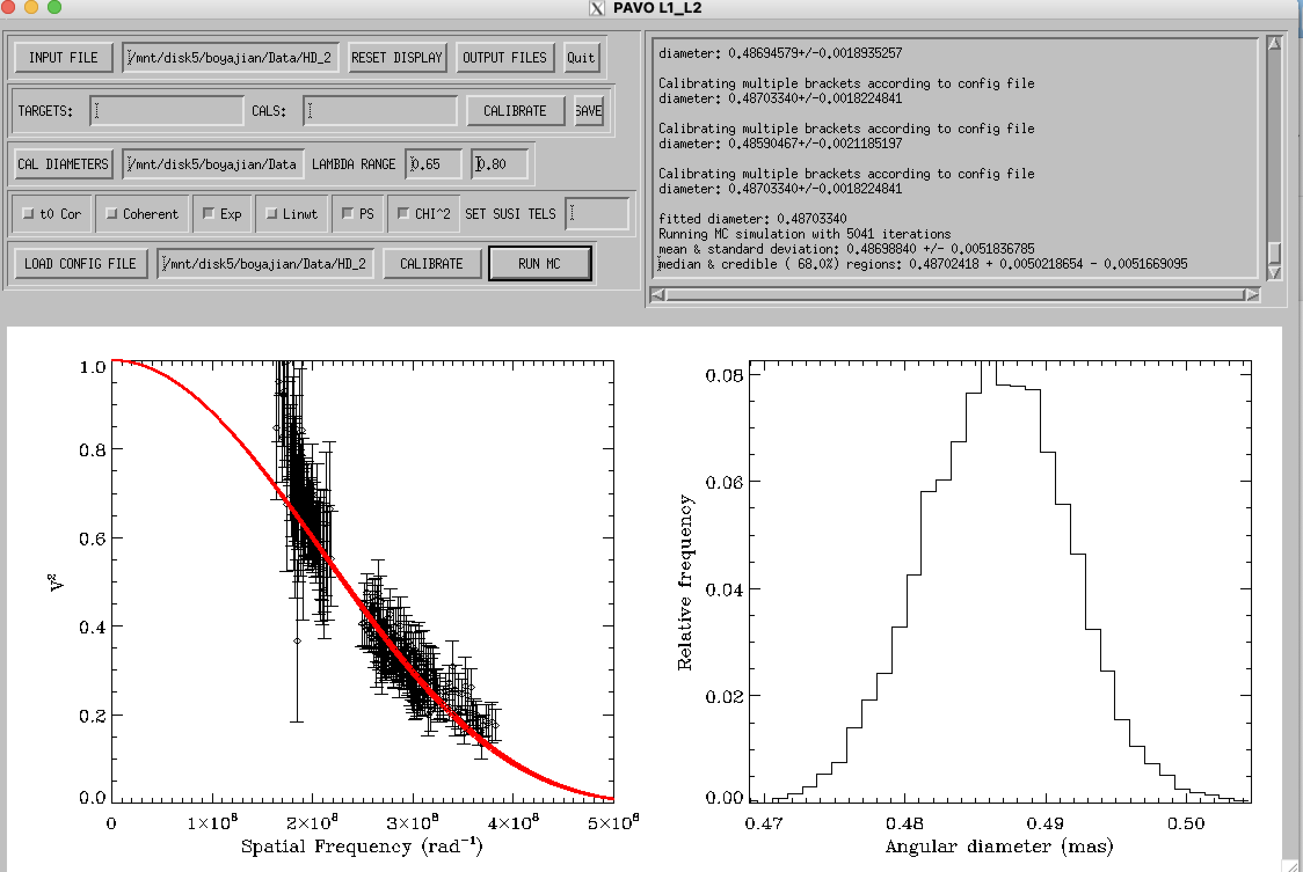
Hd 210277

Slide 24
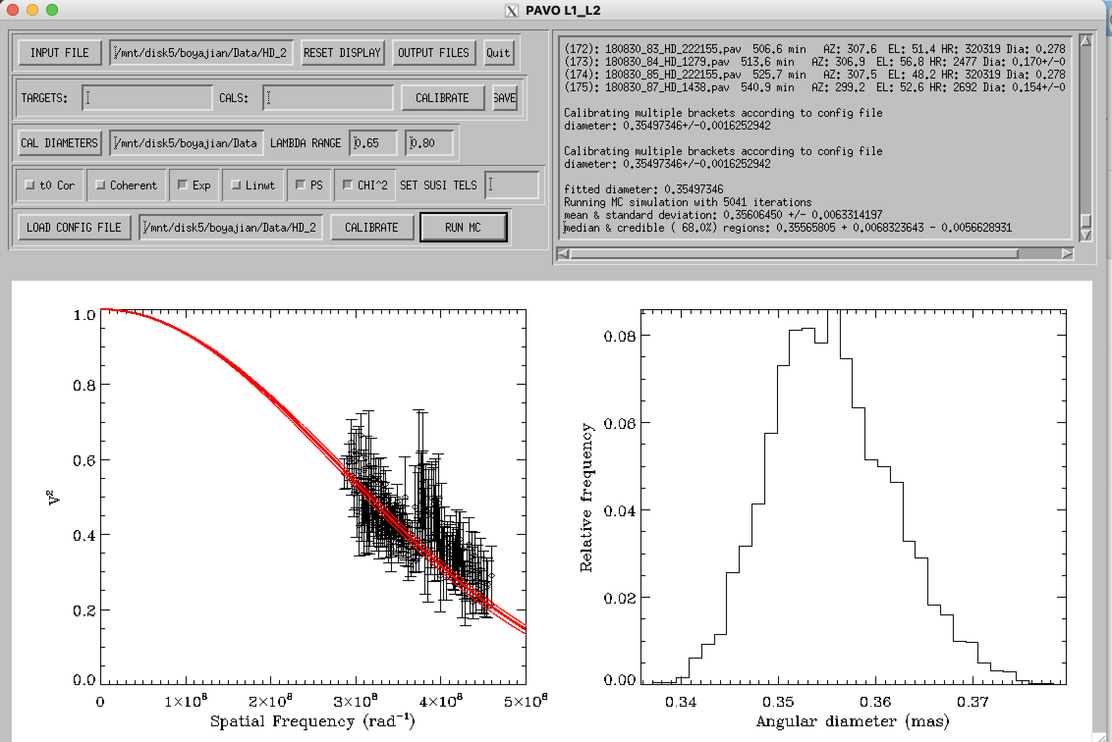
Hd 222155

Slide 25
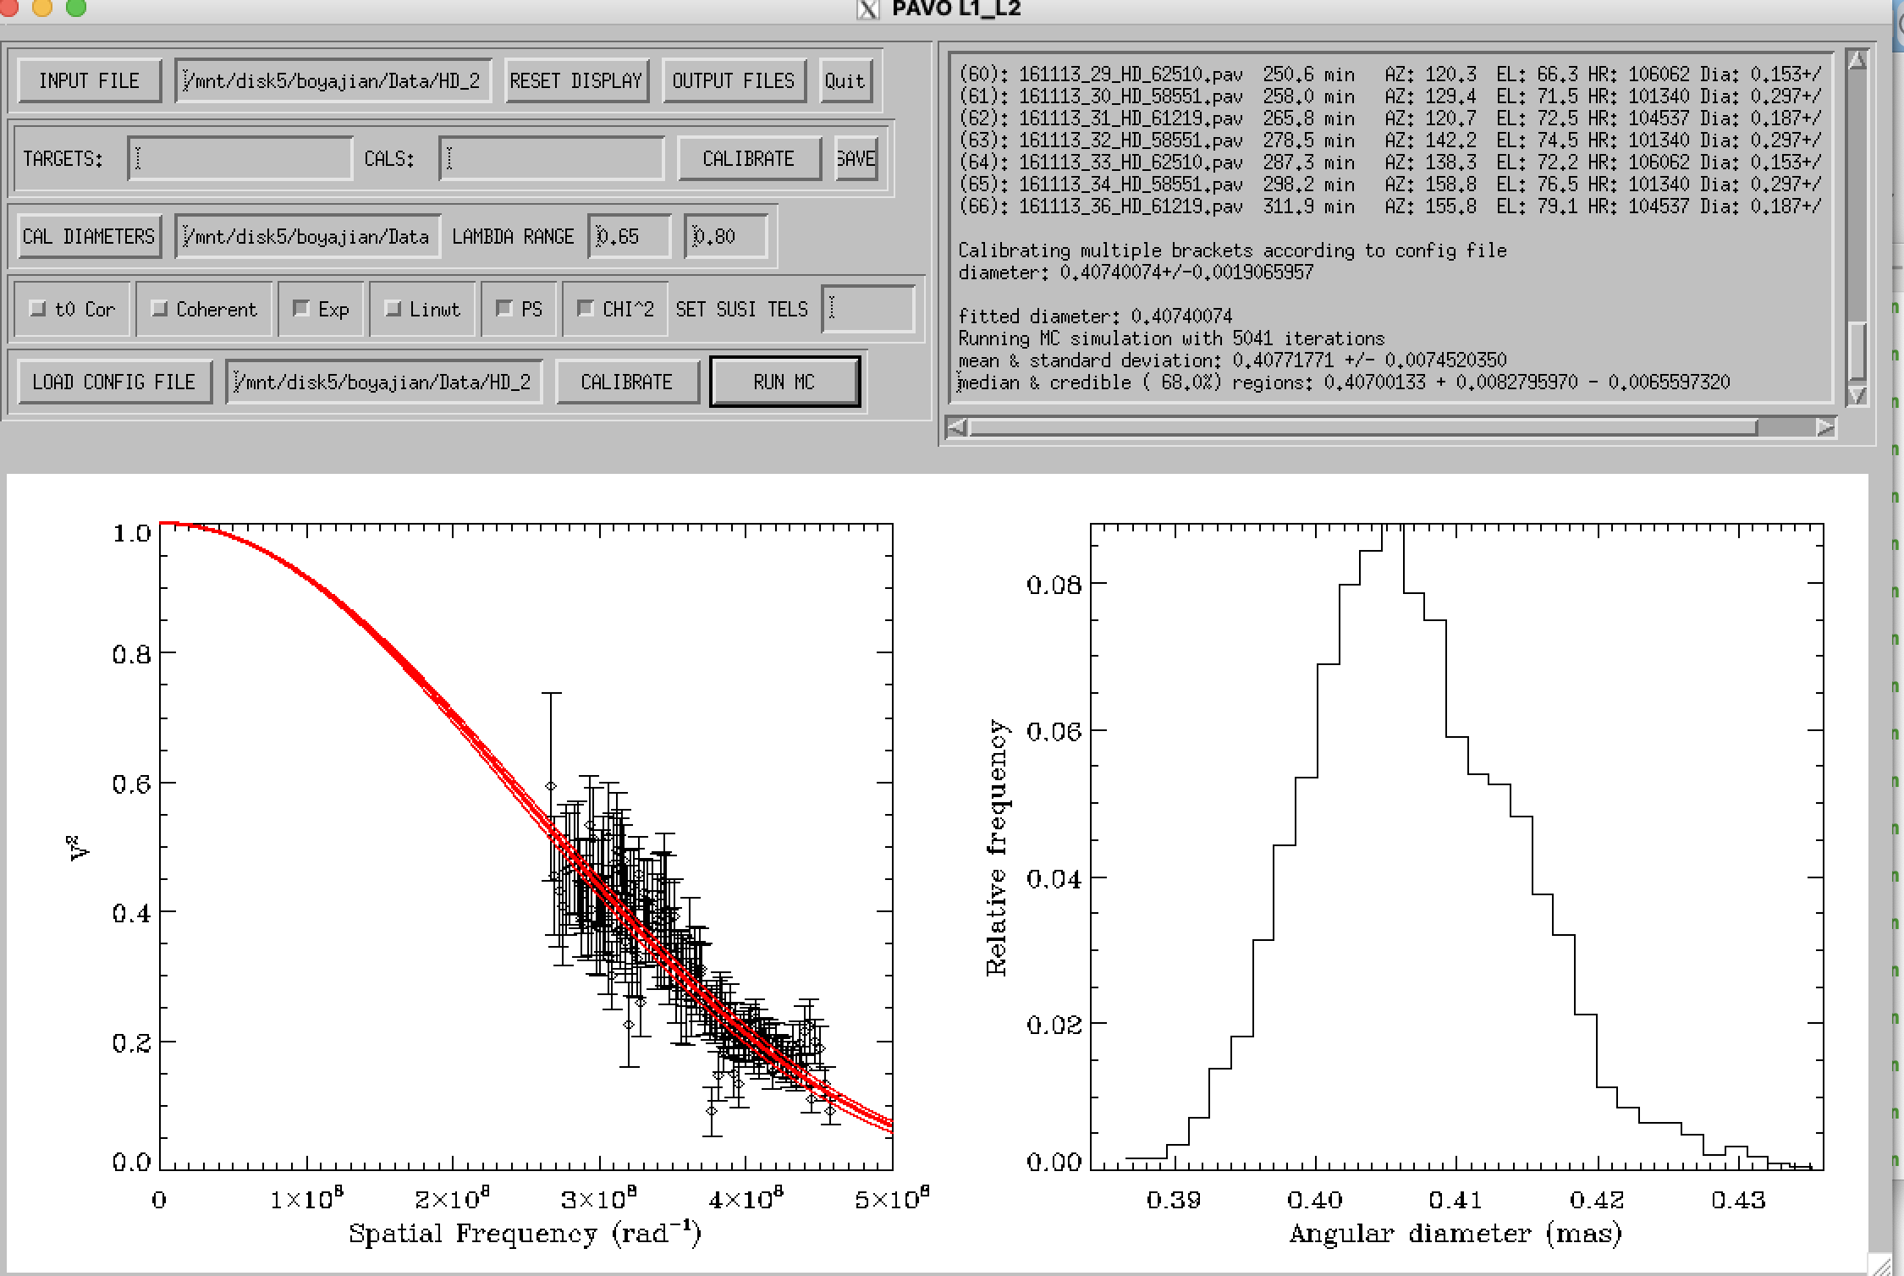
Hd 22879

Slide 26
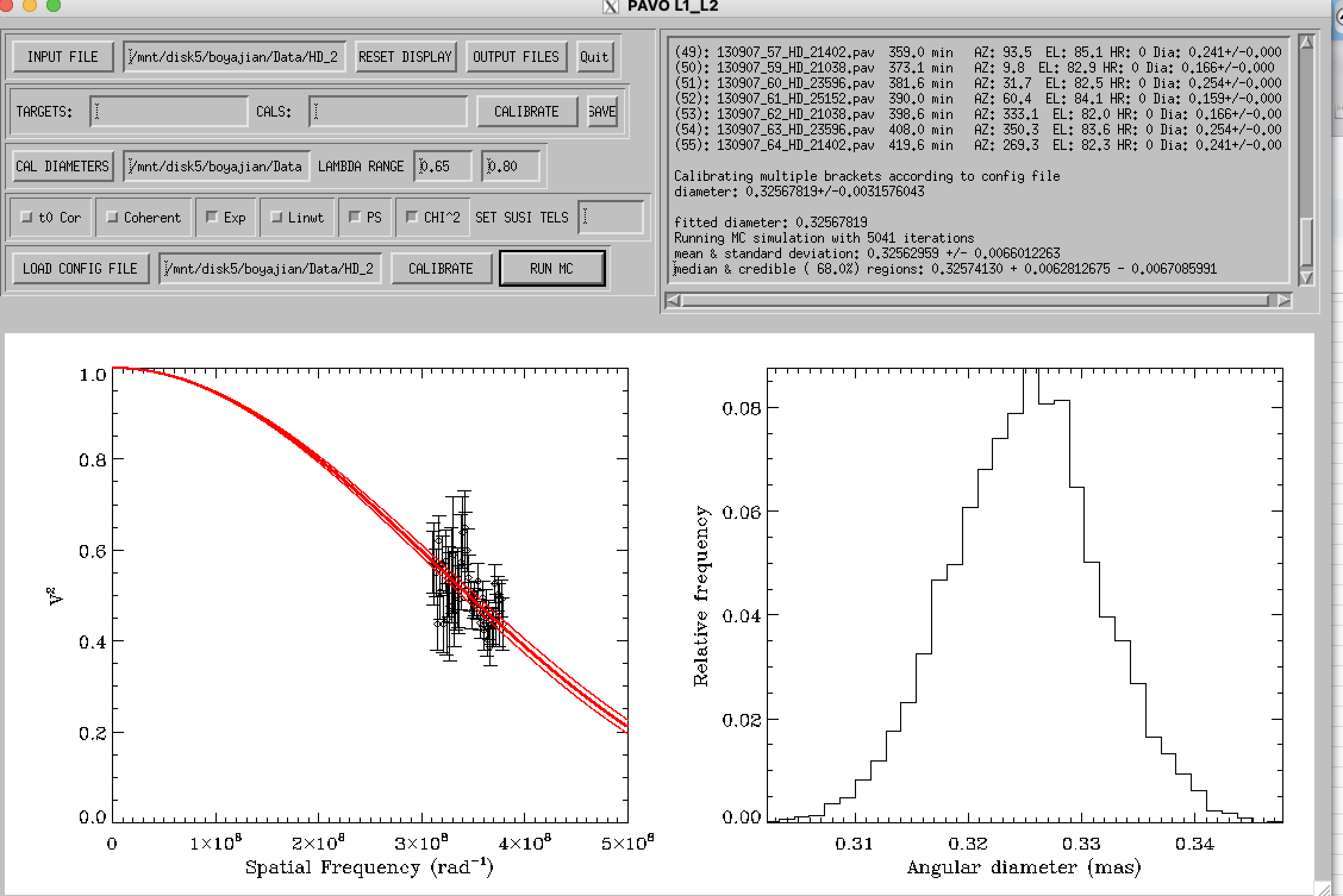
Hd 23596

Slide 27
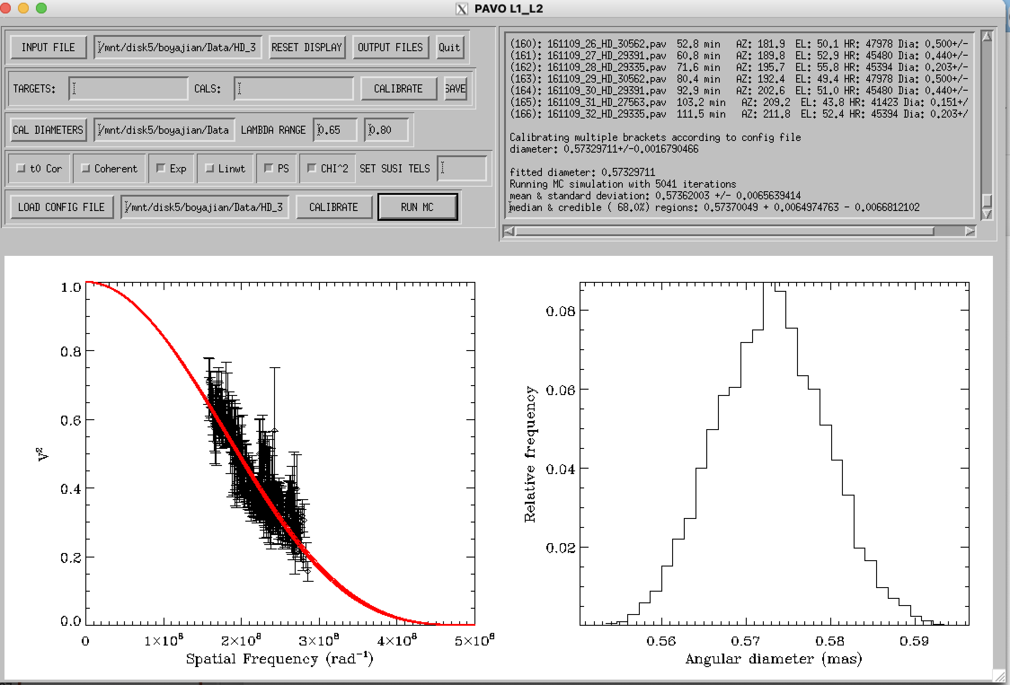
Hd 30562

Slide 28
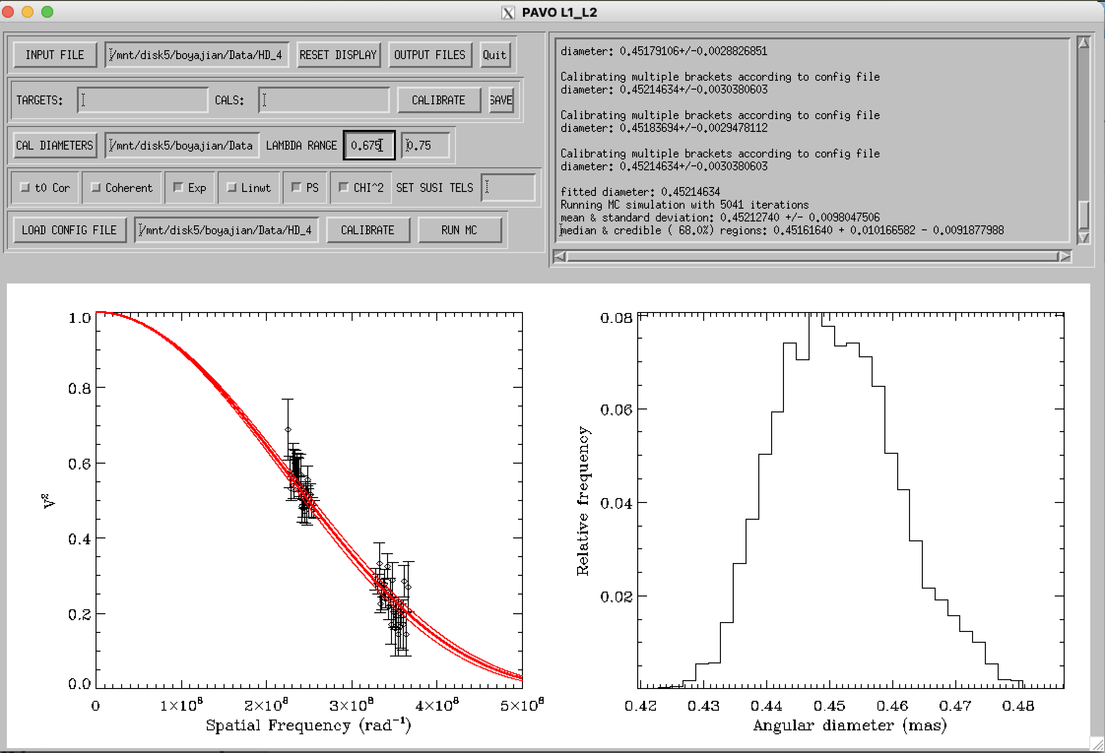
Hd 42807 wave>0.675 wave<0.755

Slide 29
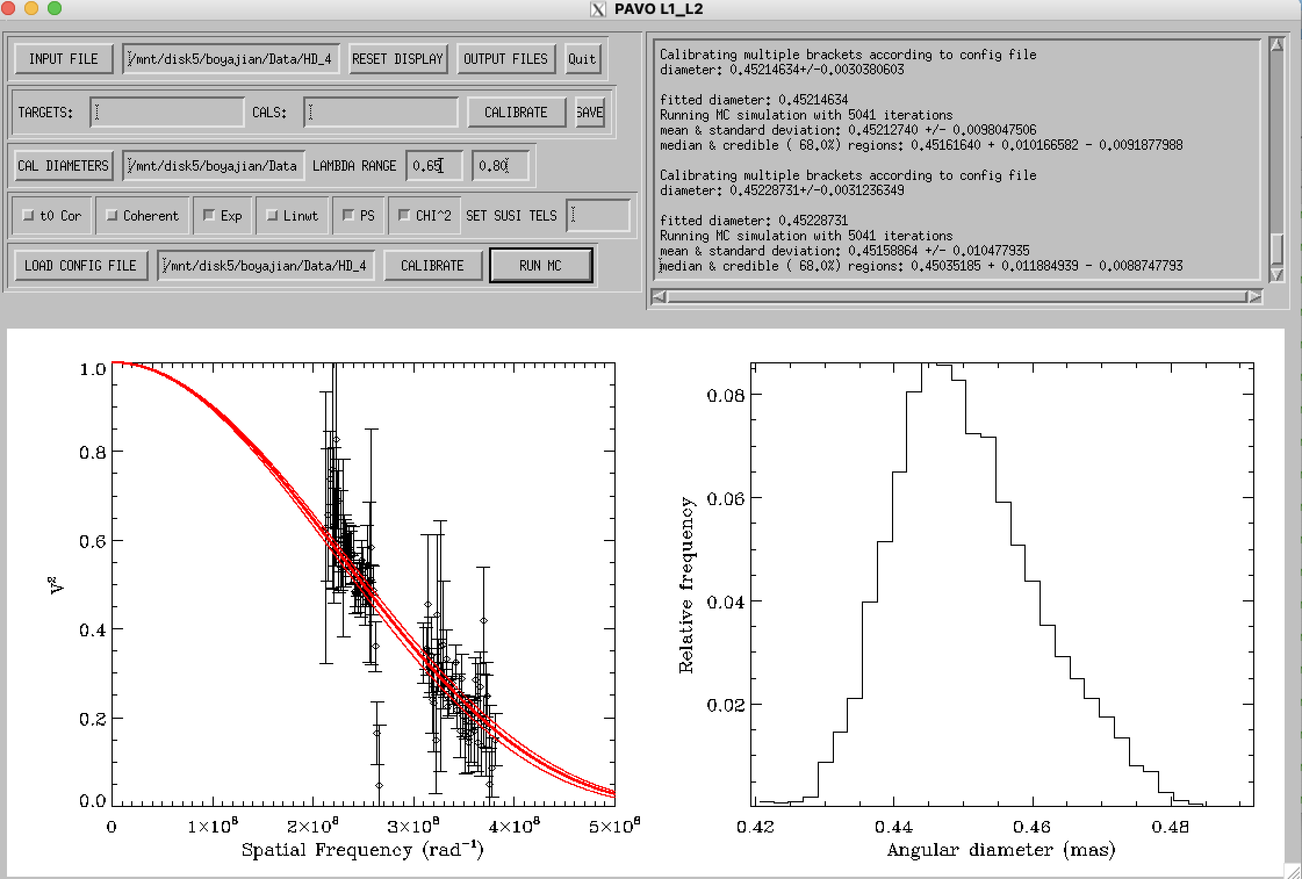
Hd 42807 all waves

Slide 30
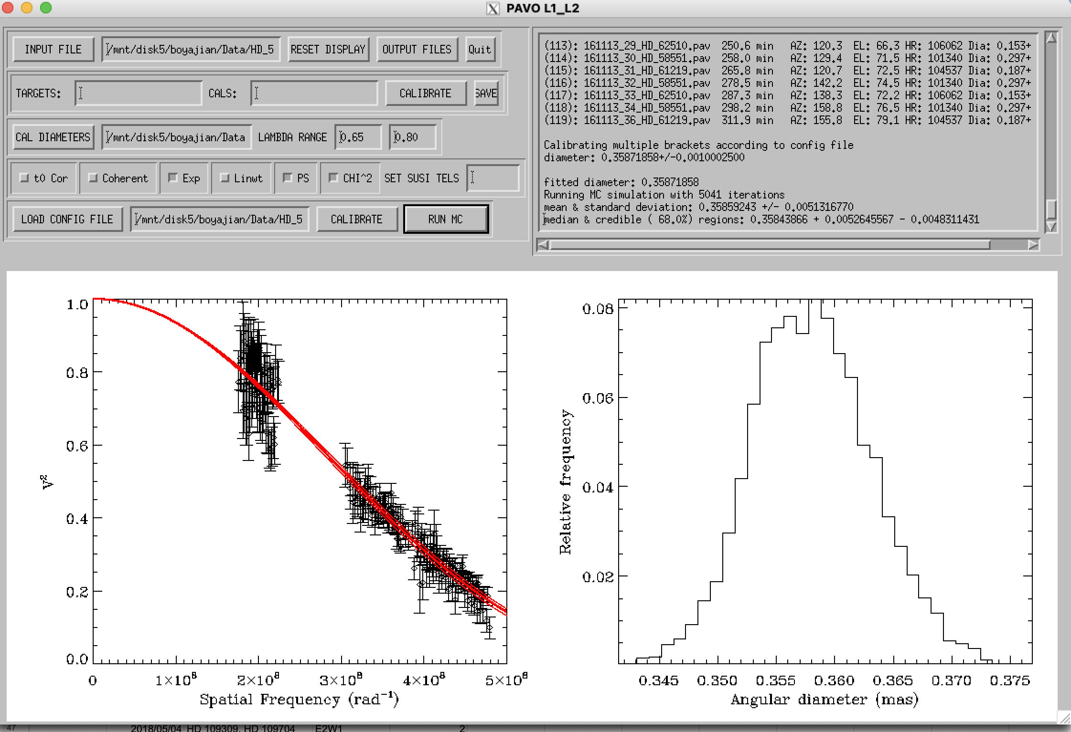
Hd 58551 iffy

Slide 31
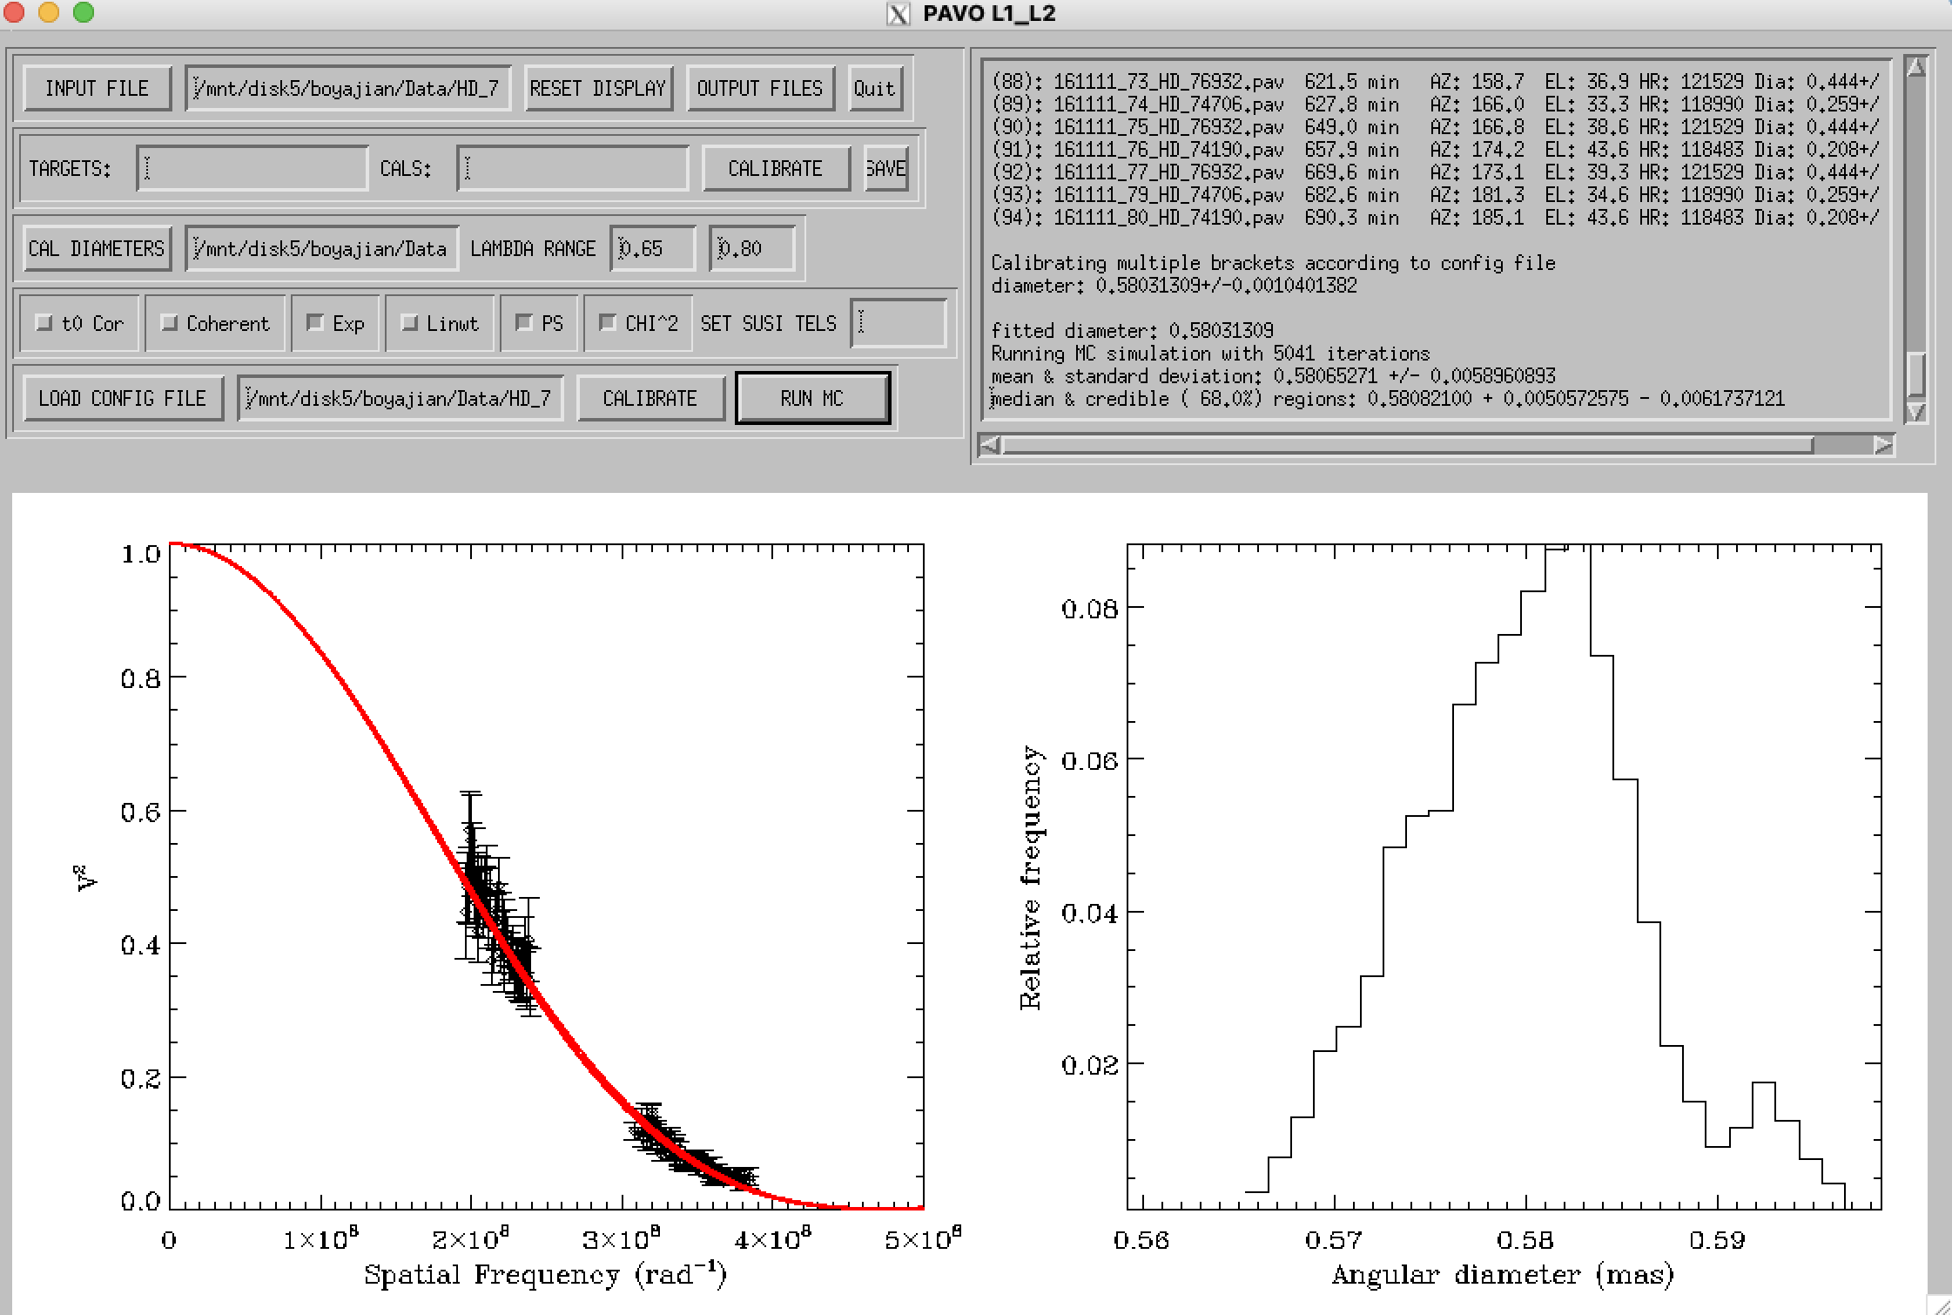
Hd 76932

Slide 32
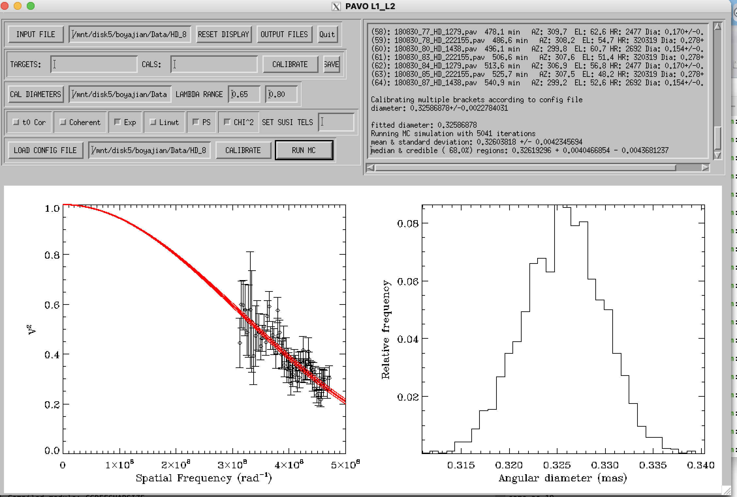
Hd 8574

Slide 33
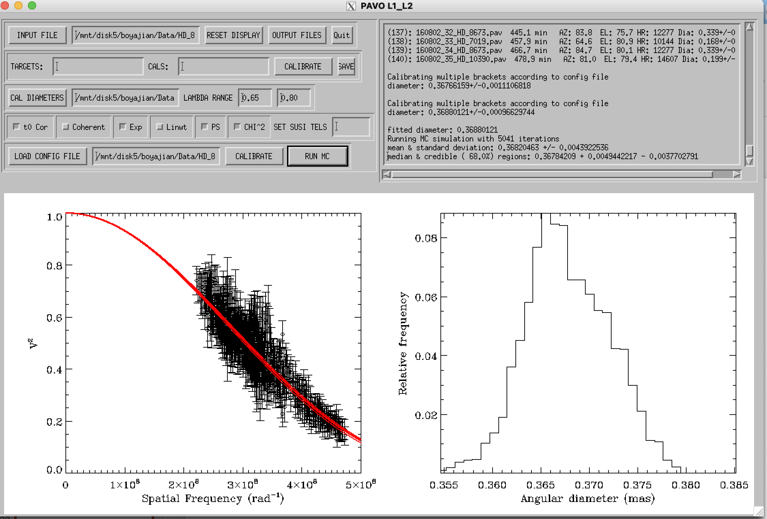
Hd 8673

